Slide 1
Scalable Learning Engine
Tianyi Chen(tchen59@jhu.edu)
Huizhan Lu(hlu27@jhu.edu)
Jian Jin(jjin20@jhu.edu)
Haitang Hu(hthu@jhu.edu)

Slide 2
Problem Definition
Dimensionality Reduction
Trade-off between lower dimensionality/lower information loss
Select most-fitted model (PCA,CCA, etc.)
Multi-view Learning
Find the relationships between different datasets.
Inputs:
Large scale data with selection-required feature distribution
Output:
Reduced features and corresponding weights
Low-dimension data (Plottable)

Slide 3
Milestones
System Construction (Week5~Week6)
Background Research
Infrastructure
Software Selection
Learning Algorithm Implementation (Week7~Week10)
PCA
CCA
TBD
TBD
Performance Optimization(Week10~Week11)
Reconstruction Accuracy Comparism
Learning Algorihm Efficiency
Learning Rate Tuning

Slide 4
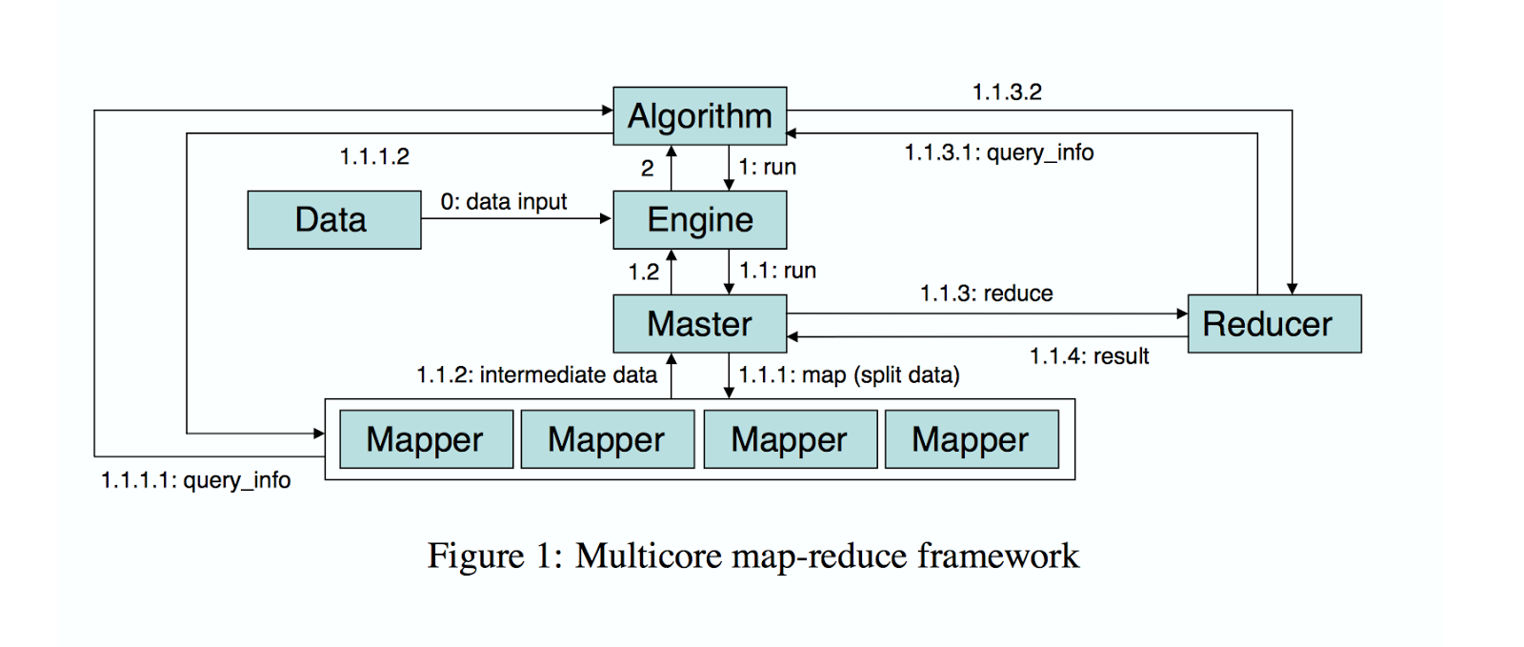
Infrastructure

Slide 5
Infrastructure
Split the dataset into instances
Assign data, run the algorithm
Collect the intermediate data and compute results

Slide 6
Language: JAVA
Java can support MPI,Hadoop Mapreduce Framework, etc. .
Apache's Hadoop framework is essentially a mechanism for analyzing huge datasets, which do not necessarily need to be housed in a datastore. Hadoop abstracts MapReduce's massive data-analysis engine, making it more accessible to developers. Hadoop scales out to myriad nodes and can handle all of the activity and coordination related to data sorting. In Hadoop, one defines map and reduce implementations by extending Hadoop's own base classes.
Java can connect database easily.

Slide 7
Learning Algorithm:
PCA:
Principal component analysis (PCA) is a statistical procedure that uses an orthogonal transformation to convert a set of observations of possibly correlated variables into a set of values of linearly uncorrelated variables called principal components. The number of principal components is less than or equal to the number of original variables. This transformation is defined in such a way that the first principal component has the largest possiblevariance (that is, accounts for as much of the variability in the data as possible), and each succeeding component in turn has the highest variance possible under the constraint that it is orthogonal to (i.e., uncorrelated with) the preceding components. Principal components are guaranteed to be independent if the data set is jointly normally distributed. PCA is sensitive to the relative scaling of the original variables.
PCA is an unsupervised method in that it does not use the output information; the criterion to be maximized is the variance. The goal is to project the data having dimensionality D onto a space having dimensionality M < D while maximizing the variance of the projected data. The learning task is to choose how many dimensions we want to project to and then pick a projection vector for each.

Slide 8
Learning Algorithm:
CCA：Canonical Correlation Analysis
Canonical correlation analysis (CCA) is a classical method for seeking correlations between two multivariate data sets. During the last ten years, it has received more and more attention in the machine learning community in the form of novel computational formulations and a plethora of applications.
canonical-correlation analysis (CCA) is a way of making sense of cross-covariance matrices. If we have two vectors X = (X₁, ..., X_{n}) and Y = (Y₁, ..., Y_{m}) of random variables, and there are correlations among the variables, then canonical-correlation analysis will find linear combinations of the X_{i} and Y_{j} which have maximum correlation with each other.

Slide 9
Evaluation and Performance Tuning
Accuracy Comparism
Learning result accuracy
Compare the reconstructed feature values to the origin values, try to minimize the loss
Learning Algorihm Architecture Refinement
Parallelize the learning algorithm through Hadhoop
Refine design/implementation of whole systems
Learning Rate Tuning
Improve learning efficiency
Converge more closer to optimum

Slide 10
Dataset
We prefer matrices data stored in Mysql.
Since we can use JDBC to connect Java and database easily.

Slide 11
Thanks!

